Slide 1




Priority-Driven Chain-Aware Scheduling with PiCAS
October 2021
Dr. Hyunjong Choi
Postdoc
University of California, Riverside
roscon.ros.org/world/2021

Slide 2

Motivation
PiCAS framework
PiCAS on reference system
roscon.ros.org/world/2021

Slide 3

Motivation
roscon.ros.org/world/2021

Slide 4


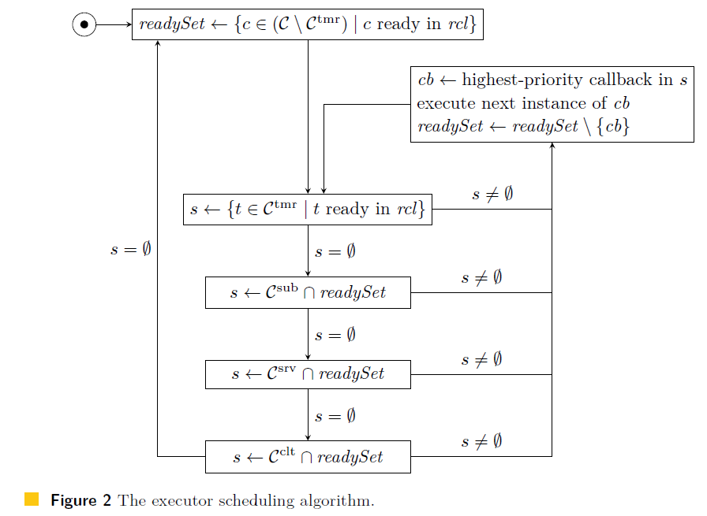
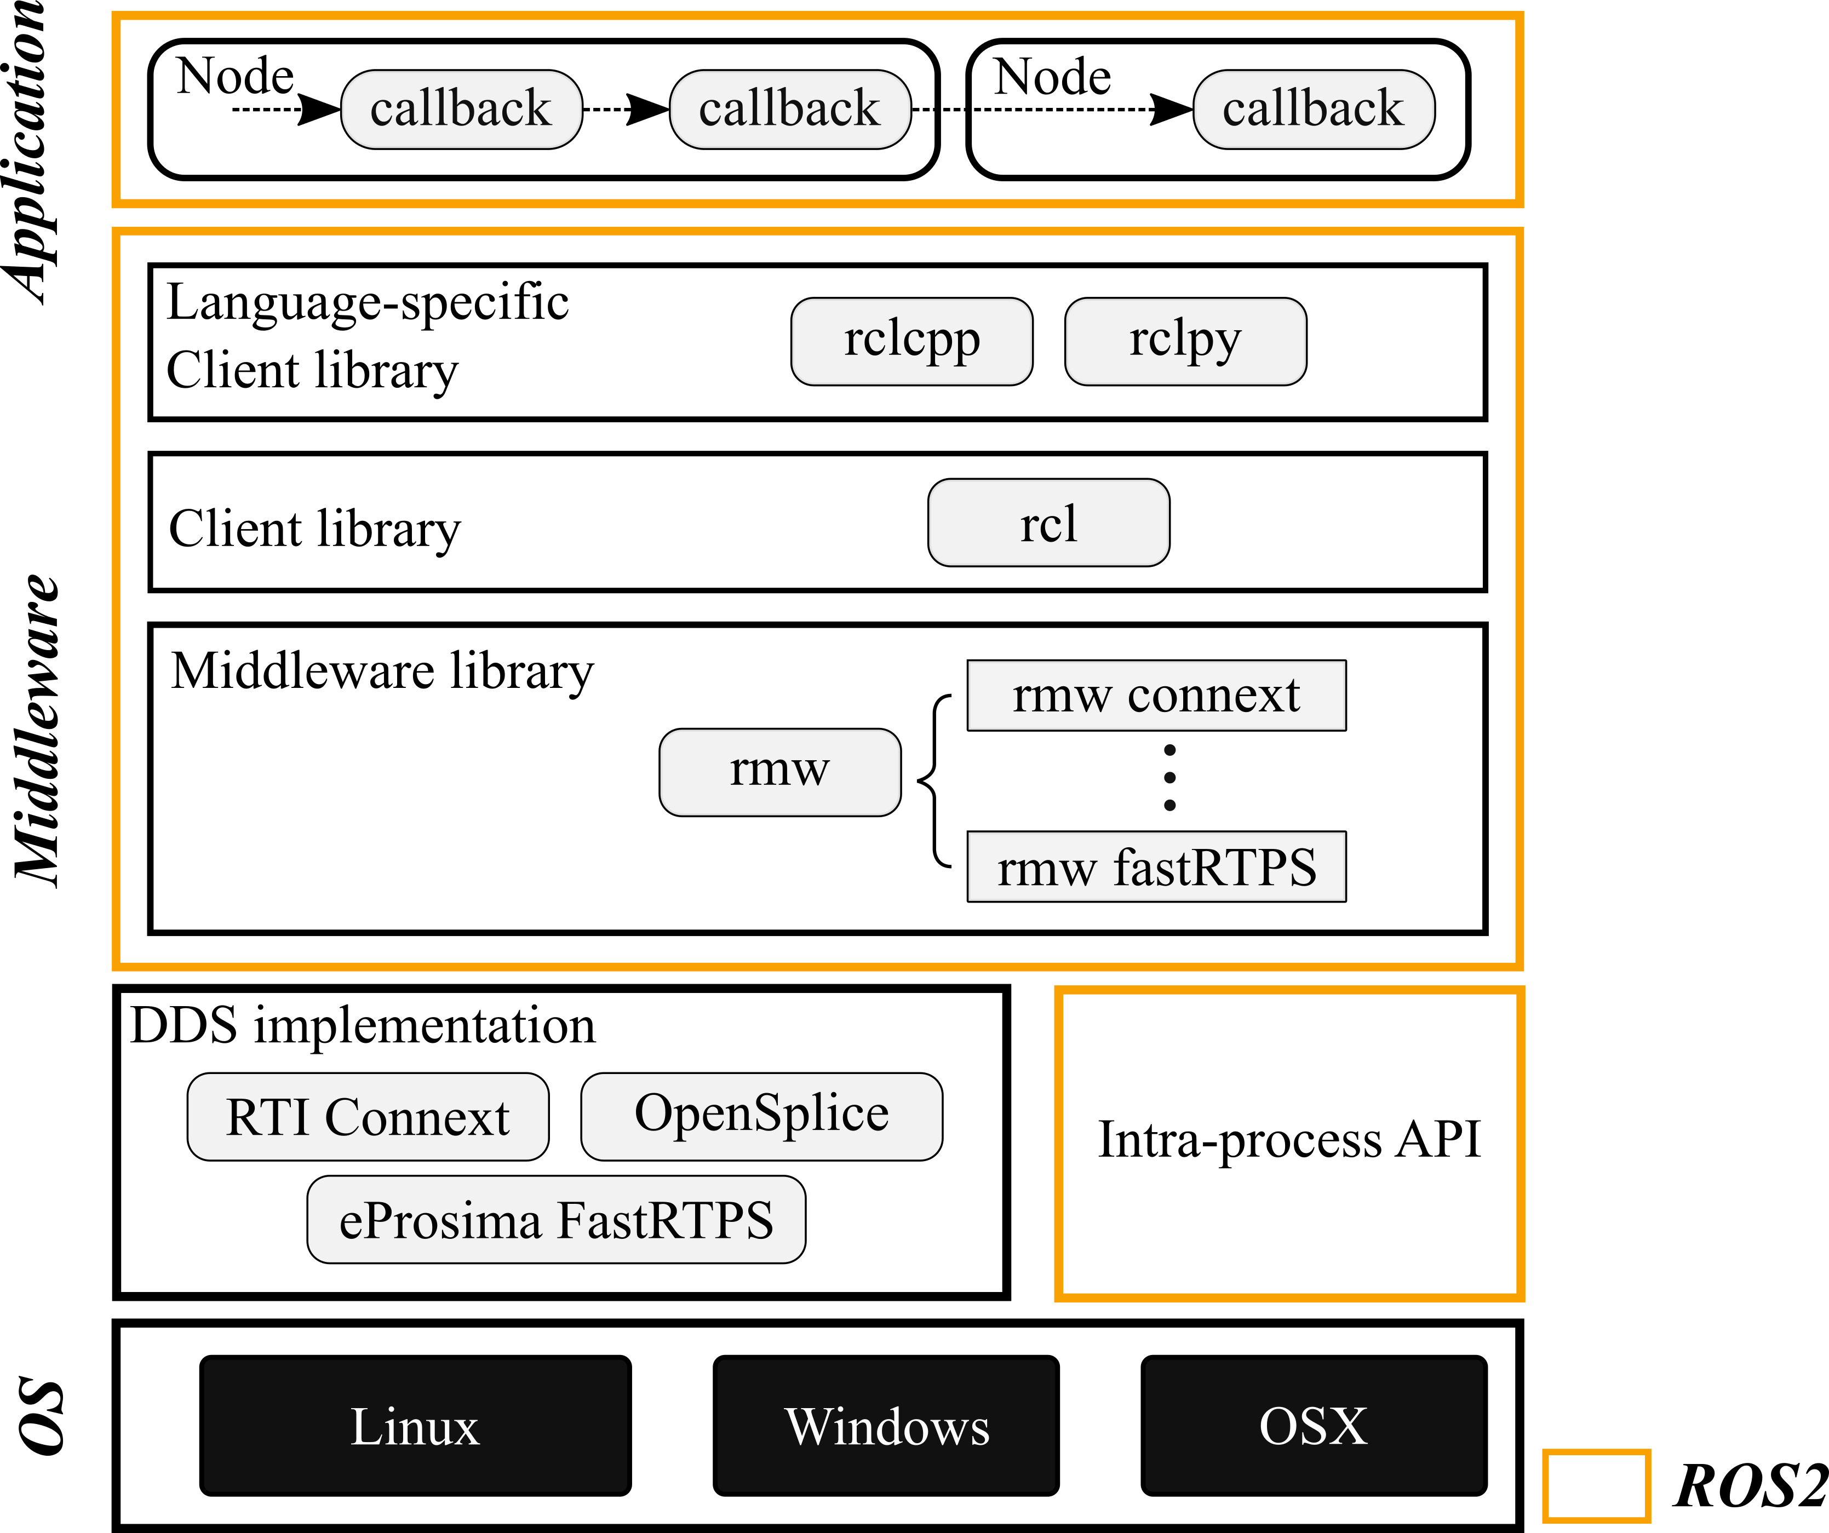
Motivation
ROS 2 executor scheduling
Executor
ready queue
CB
fetch
callback
Timer callback
Problems
Suffers from priority inversion
No systematic resource allocation methods
Complex and pessimistic to analyze
Difficult to prioritize critical chains
CB
CB
CB
< ROS2 architecture >
< Callback scheduling of executor† >
† D. Casini et al. “Response-time analysis of ROS 2 processing chains under reservation-based scheduling”, ECRTS, 2019
roscon.ros.org/world/2021

Slide 5
PiCAS Framework
roscon.ros.org/world/2021

Slide 6
PiCAS: Priority-driven Chain-Aware Scheduling framework for ROS2
Key idea: enables prioritization of mission-critical chains across complex abstraction layers of ROS 2
To minimize end-to-end latency
To ensure predictability even when the system is overloaded
PiCAS: Executor + Resource Allocation Algorithms + Timing Analysis
PiCAS executor: priority-driven callback scheduling
Resource allocation algorithms
Callback Priority Assignment
Chain-Aware Node-to-Executor Allocation
Executor Priority Assignment
Backed by formal end-to-end latency analysis
roscon.ros.org/world/2021

Slide 7
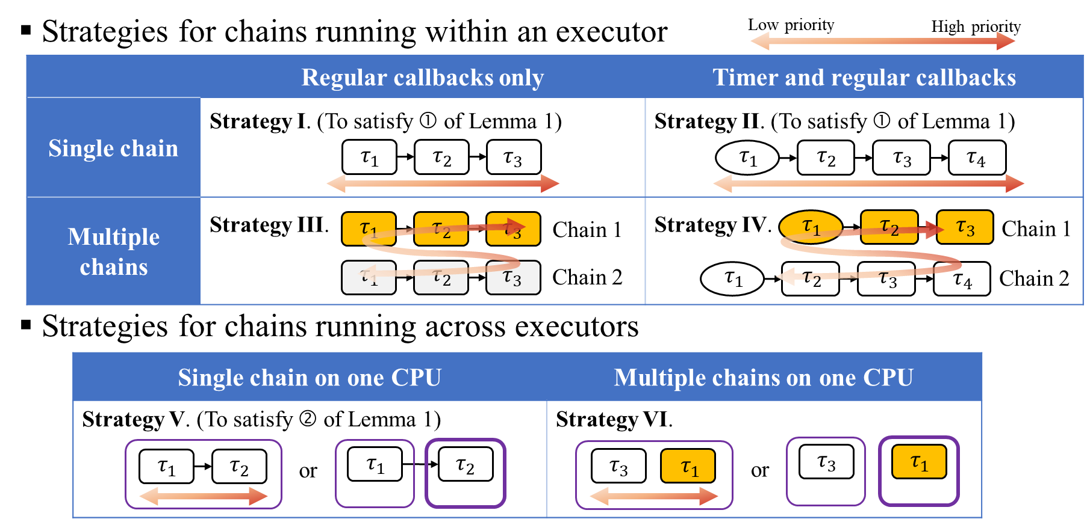

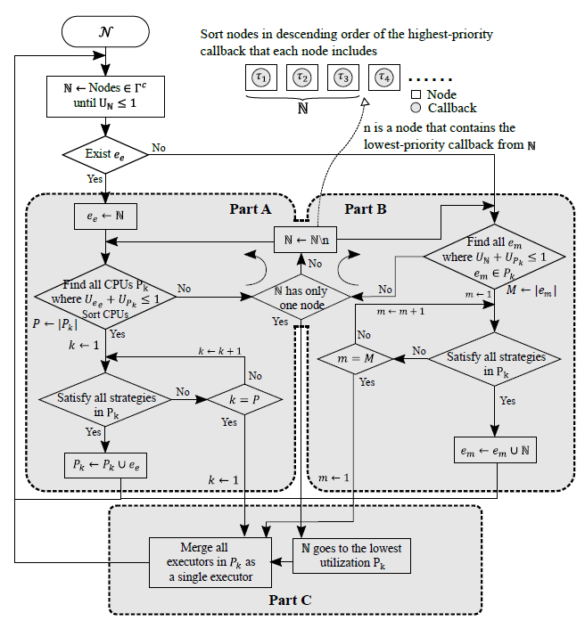

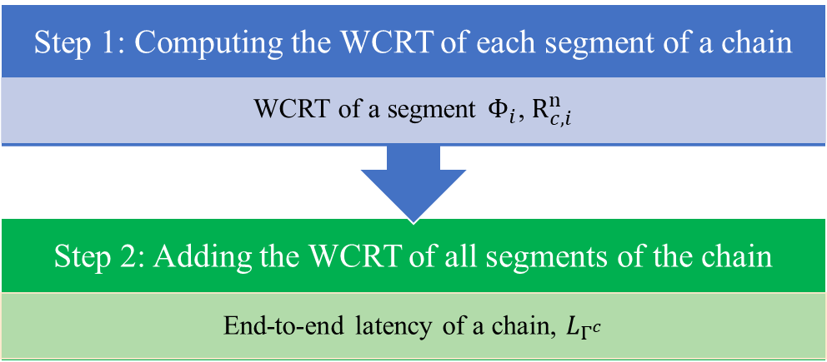
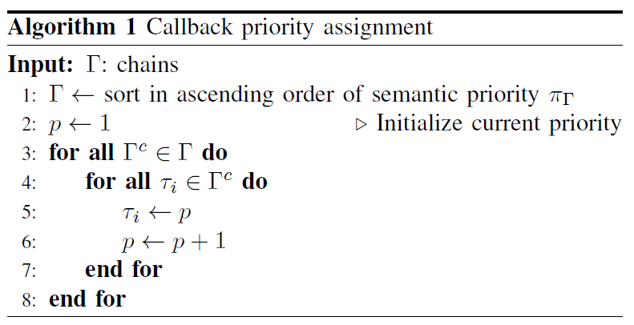
PiCAS Algorithms
< Node-to-Executor allocation >
< Chain-aware scheduling strategies >
< End-to-end timing analysis >
< Priority assignment >
For details, please see our paper:
Hyunjong Choi, Yecheng Xiang, and Hyoseung Kim, PiCAS: New Design of Priority-Driven Chain-Aware Scheduling for ROS2. In IEEE Real-Time and Embedded Technology and Applications Symposium (RTAS), 2021. [ Paper | Slides | Video ]
roscon.ros.org/world/2021

Slide 8
PiCAS Executor (1/2)
Implemented as an extension to the rclcpp wait-set executor
PiCAS executor API
Default parameters
// Set RT priority and CPU affinity of executor instance
void Executor::set_executor_priority_cpu(int priority, int cpu);
// Enable/Disable priority-based callback scheduling
void Executor::enable_callback_priority();
void Executor::disable_callback_priority();
// Set callback priority
void Executor::set_callback_priority(rclcpp::TimerBase::SharedPtr ptr, int priority);
void Executor::set_callback_priority(rclcpp::SubscriptionBase::SharedPtr ptr, int priority);
void Executor::set_callback_priority(rclcpp::ServiceBase::SharedPtr ptr, int priority);
void Executor::set_callback_priority(rclcpp::ClientBase::SharedPtr ptr, int priority);
void Executor::set_callback_priority(rclcpp::WaitableBase::SharedPtr ptr, int priority);
// Spin for PiCAS (RT executor priority & CPU affinity)
void SingleThreadedExecutor::spin_rt();
class Executor
{ ...
#ifdef PICAS
bool callback_priority_enabled = false;
int executor_priority = 0;
int executor_cpu = 0;
executor.hpp
...
#ifdef PICAS
int callback_priority = 0;
#endif
...
client.hpp, service.hpp, timer.hpp, subscription_base.hpp, waitable.hpp
roscon.ros.org/world/2021

Slide 9
PiCAS Executor (2/2)
Bool Executor::get_next_ready_executable
{
...
memory_strategy_->get_next_waitable(any_exe, weak_nodes);
if (any_exe.cb && highest_priority < any_exe.waitable->callback_priority) {
highest_priority = any_executable.waitable->callback_priority;
any_executable.timer = nullptr;
any_executable.subscription = nullptr;
any_executable.service = nullptr;
any_executable.client = nullptr;
}
else any_executable.waitable = nullptr;
...
}
Implementation details
Pro: waiting time for high-priority callback can be minimized
Con: overhead; not good for high throughput of short, same-priority callbacks
Bool Executor::get_next_executable
{
bool success = false;
if (!success) {
wait_for_work(timeout);
}
success = get_next_ready_executable(any_executable);
...
}
Update wait-set whenever each callback completes
Select the highest priority callback among all ready callbacks
get_next_executable of executor.cpp (PiCAS)
get_next_ready_executable of executor.cpp (PiCAS)
Callbacks can be scheduled based on their priorities
roscon.ros.org/world/2021

Slide 10
PiCAS on reference system
roscon.ros.org/world/2021

Slide 11
PiCAS on reference system
Clone our forked repository
Build with PiCAS executor
Use PICAS CMake variable
Configuration change for Linux RT priority
Modify /etc/security/limits.conf
Notes
PiCAS is implemented as an extension to rclcpp, located in reference-system/rclcpp. This local rclcpp overrides the default ROS2 rclcpp.
If -DPICAS=FALSE, reference-system/rclcpp is exactly the same as the ROS2 Galactic version.
git clone https://github.com/rtenlab/reference-system.git
colcon build --cmake-args -DRUN_BENCHMARK=TRUE -DTEST_PLATFORM=TRUE -DPICAS=TRUE
<userid> hard rtprio 99
<userid> soft rtprio 99
roscon.ros.org/world/2021

Slide 12
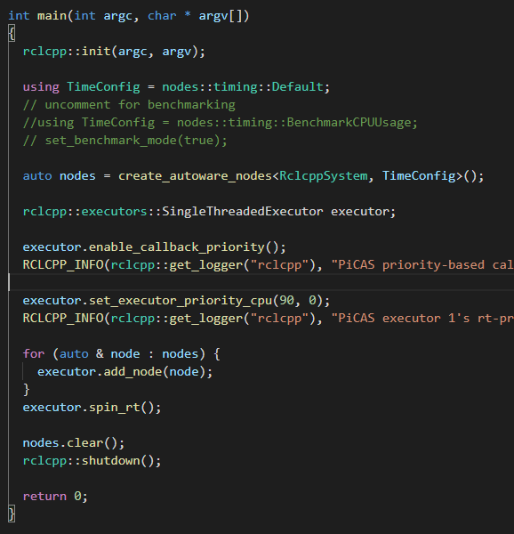
How to use PiCAS executor
Declaration of executor
Enable callback priority (PiCAS executor)
callback_priority_enabled = true
Set executor’s real-time priority and assign CPU
Executor (process) scheduled under SCHED_FIFO policy that has a sched_priority value in the range 1 (low) to 99 (high).
Allocate nodes to executor
std::thread spinThread(&rclcpp::executors::SingleThreadedExecutor::spin_rt, &executor);
Run executor (spin_rt())
autoware_default_singlethreaded_picas_single_executor.cpp
roscon.ros.org/world/2021

Slide 13
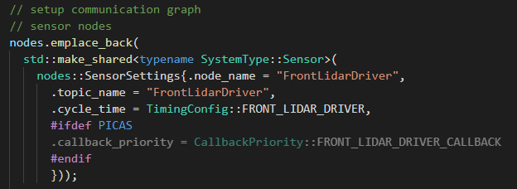
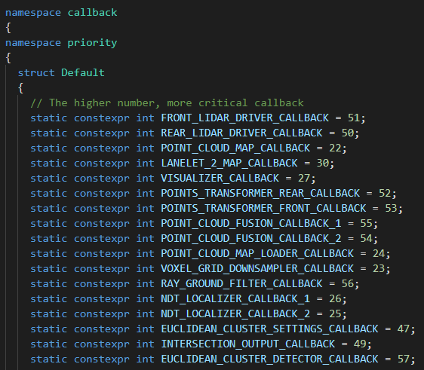
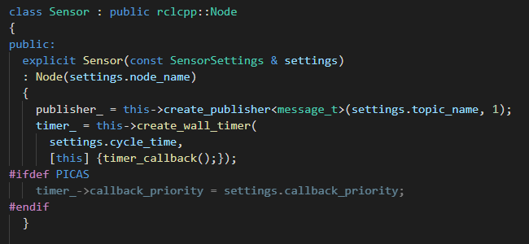
How to assign callback priority
Callback priority assignment on reference system
Or, use API, e.g.,
Set unique priority to callbacks
autoware_reference_system/include/autoware_reference_system/autoware_system_builder.hpp
autoware_reference_system/system/priority/default.hpp
reference_system/include/reference_system/nodes/rclcpp/nodes.hpp
executor.set_callback_priority(node->callback, priority)
roscon.ros.org/world/2021

Slide 14
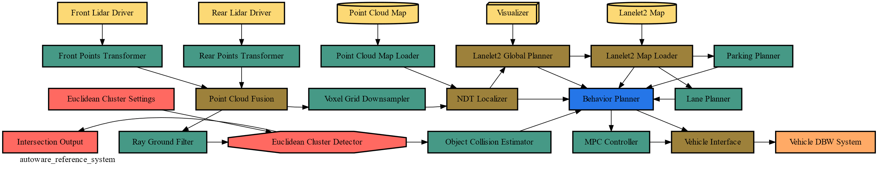
Evaluation
Autoware model
Single executor instance & multiple executor instances
Based on the PiCAS priority assignment and node-to-executor allocation algorithms
Algorithm implementation: https://github.com/rtenlab/ros2-picas
23
22
1
6
9
25
24
8
11
10
12
3
27
26
5
7
14
15
17
13
2
4
18
16
19
31
32
21
28
20
35
33
29
30
34
36
>
>
: Criticality of chains
Number (the higher, more critical)
: Priority of callback
: hot topic path (latency is the one of KPIs)
roscon.ros.org/world/2021

Slide 15
Evaluation
Experiment environment
Raspberry Pi 4 with fixed CPU frequency of 1.5GHz
4 CPU cores for multiple executors (PiCAS) and multithreaded executor (ROS2 default)
Run with RUN_TIMES option of 60 seconds
Evaluation criteria : Key Performance Indicators (KPIs) of reference system
colcon test
roscon.ros.org/world/2021

Slide 16
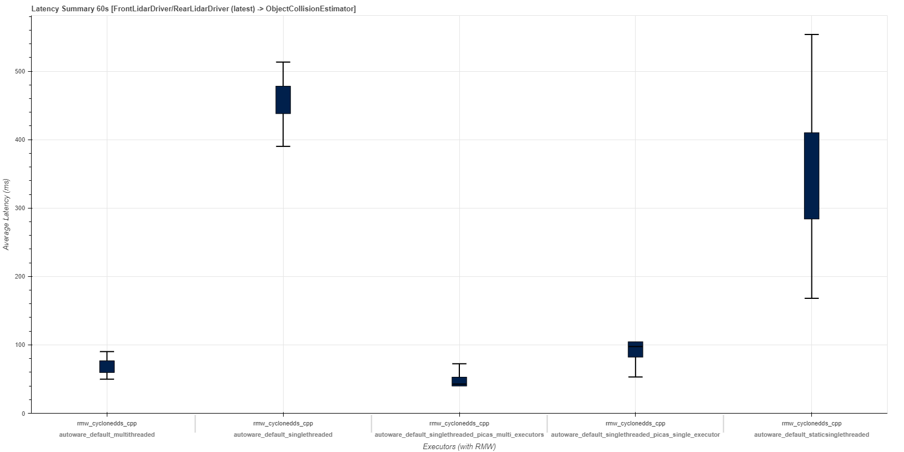
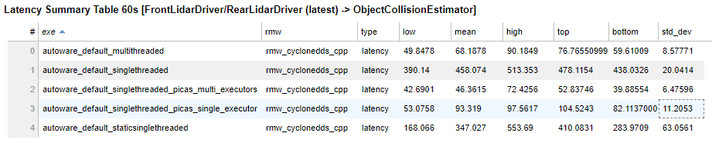
Evaluation
Latency summary
Default-static singlethreaded
Default-single threaded
PiCAS-single
executor
Default-multi threaded
PiCAS-multiple executors
roscon.ros.org/world/2021

Slide 17
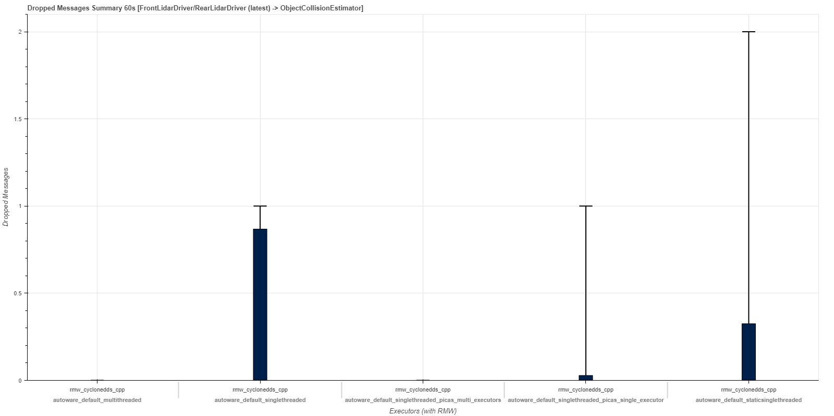
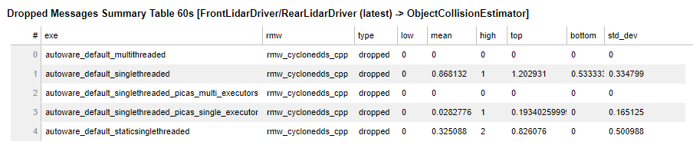
Evaluation
Dropped messages summary
Default-static singlethreaded
Default-single threaded
PiCAS-single
executor
Default-multi threaded
PiCAS-multiple executors
roscon.ros.org/world/2021

Slide 18
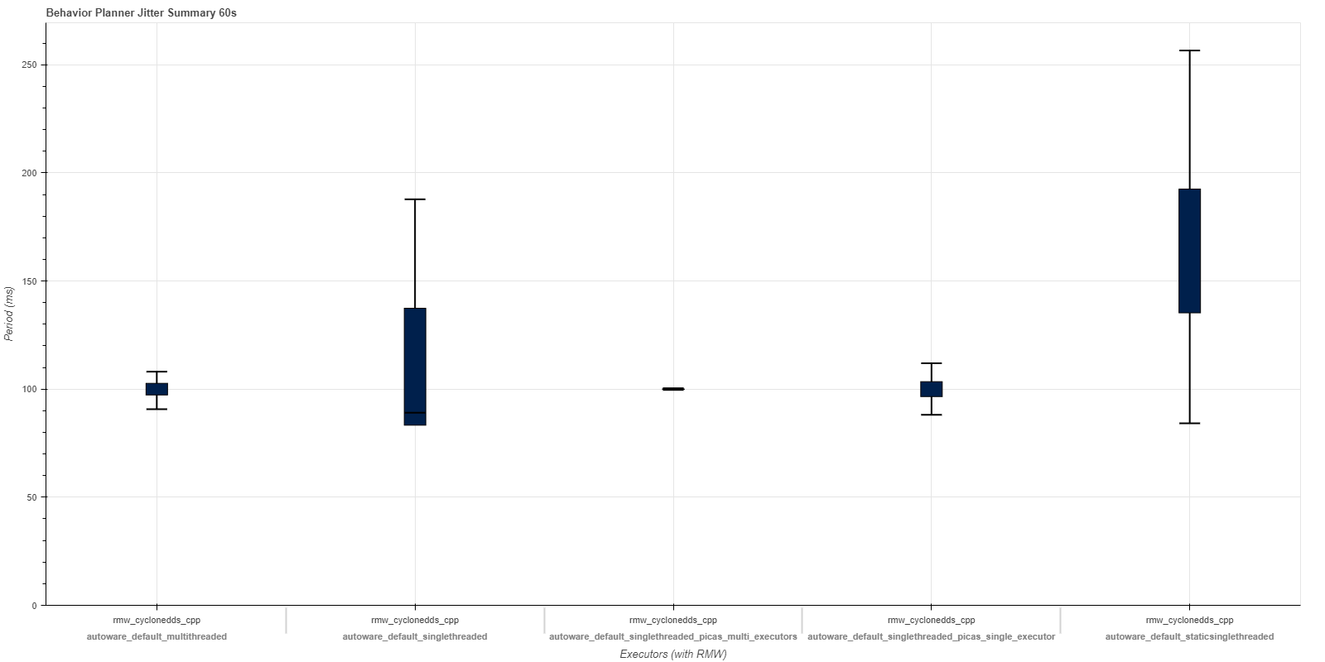
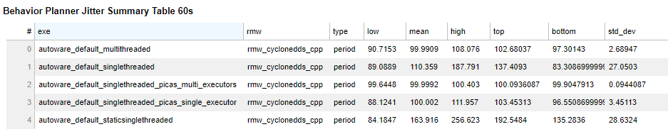
Evaluation
Behavior planner jitter
Default-static singlethreaded
Default-single threaded
Default-multi threaded
PiCAS-multiple executors
PiCAS-single
executor
roscon.ros.org/world/2021

Slide 19
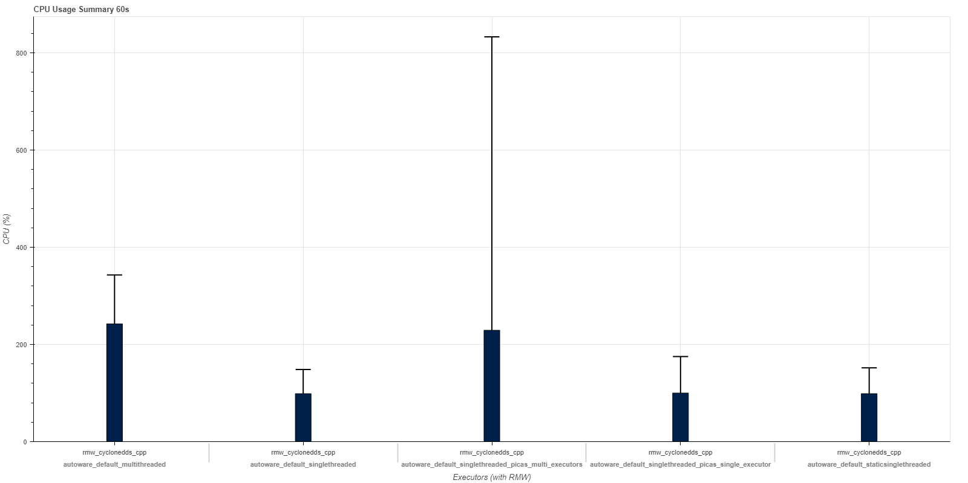
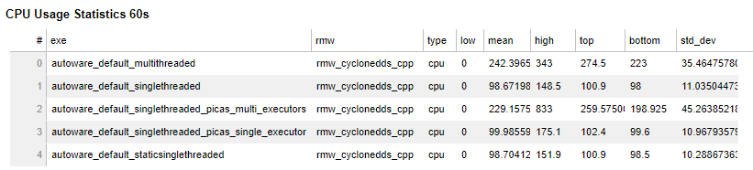
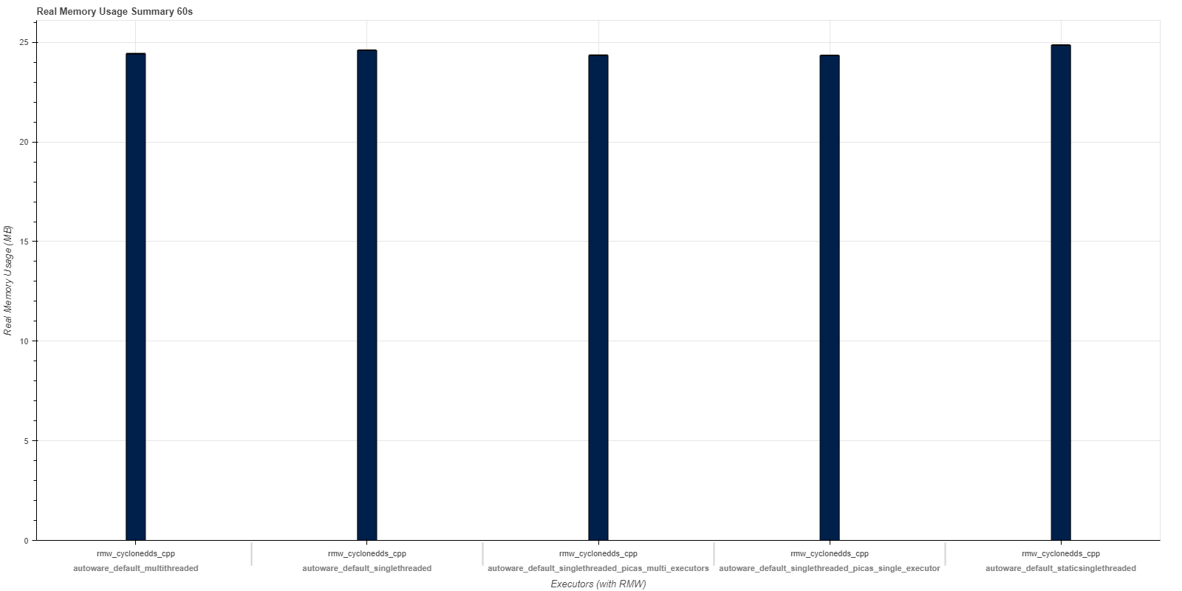
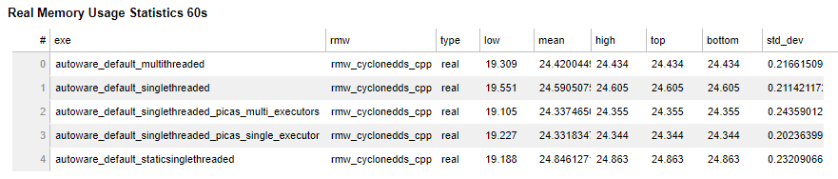
Evaluation
CPU usage summary
Memory usage summary
Default-single threaded
Default-multi threaded
PiCAS-multiple executors
Default-static singlethreaded
PiCAS-single
executor
Default-static singlethreaded
Default-single threaded
PiCAS-single
executor
Default-multi threaded
PiCAS-multiple executors
roscon.ros.org/world/2021

Slide 20
Thank you
Q & A
https://github.com/rtenlab/reference-system
roscon.ros.org/world/2021

